Slide 1

TA201T: Introduction to Manufacturing Processes I
2020-21 Semester I
Manufacturing Case Study
RAILWAY TRACKS
Name: Tejesh Vaish
Roll No.: 190908
Section : S-5
Tutor: Sourav Ghosh
Instructor: Dr. Anish Upadhyaya

Slide 2
Outline
PART 1
Introduction
Material Tetrahedron
Rail Steel
Material structure (microstructure as well as shape & size) and Properties.
PART 2
Manufacturing processes of Railway tracks .
Continuous Casting , Rolling , heat Treatment .
Grain Size effect on mechanical properties
New - Head Hardening.
References

Slide 3
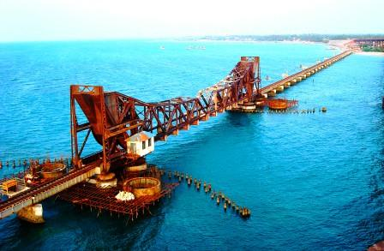
PART 1
Pamban bridge , an engineering marvel , our nation's pride !
Who thought that railway track would be built over ocean !

Slide 4
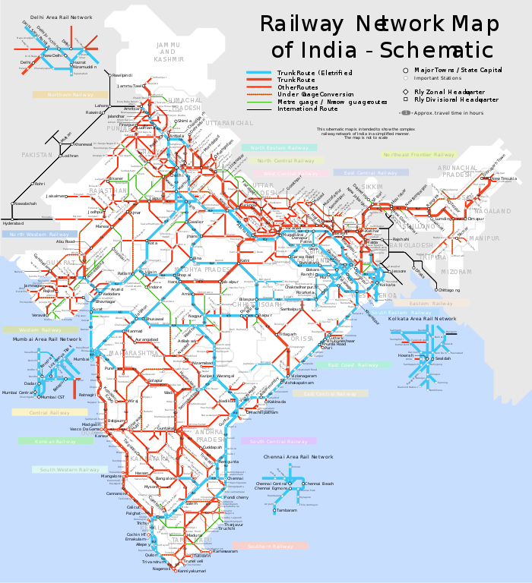
Introduction
Railways are truly the backbone of a nation .
It is because of railways that the people and material are able to transport to such a large distances at such a low fare !
The railways have connected almost all of the major cities of India , and this length is gigantic 65,000 km alone in our country !
This clearly hints at the marvelous manufacturing process of rail , which must be working continuously to build even more tracks .
Indian railways are third largest in the world rail network currently !

Slide 5
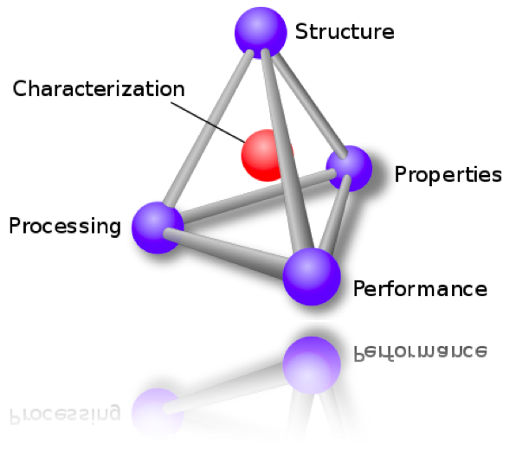
Material Tetrahedron
Application : To manufacture rails for railways tracks
Properties : Flexible , high tensile and yield strength .
Material : Steel with varying concentration of carbon , manganese and silicon , popularly known as rail steel .
Processing : Casting , Rolling , Heat - treatment , straightening .

Slide 6
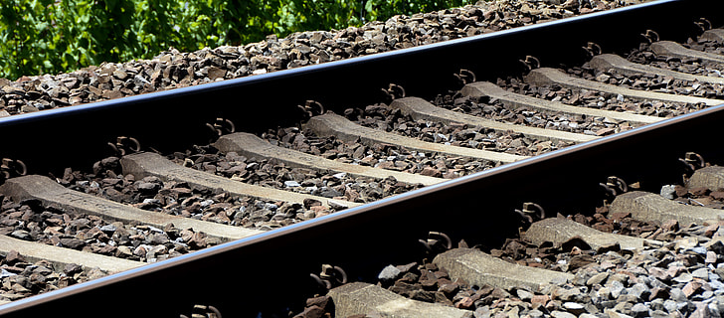
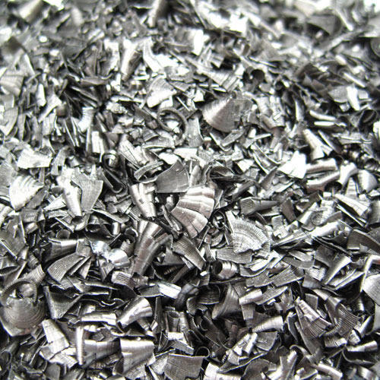
Rail Steel
Rail steel is mainly used for making railway lines , cranes , transfer cars , etc.
It can be very well seen that how important these rail steel are , as the rail have to stand years of service under high stress and constant contraction - expansion every season .
Surprisingly , there is no difference between the structure of grain of new rail and old rail.
raw Iron from which Steel will be made

Slide 7
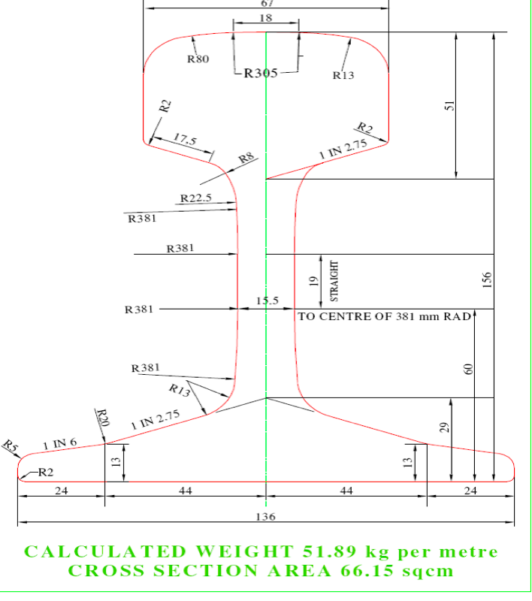
Material structure
Head
The head provides smooth running surface for the trains and have minimum wear .
A base is wide enough to provide stability .
Effect of Different elements in Steel :-
Carbon content increases UTS , hardness and yield point but decreases ductility.
Chromium increases UTS
Silicon ,manganese and aluminum acts as Deoxidizing agent .
Phosphorus leads to cold shortness .
Sulphur causes segregation .
hydrogen and nitrogen are just impurity .
Base

Slide 8
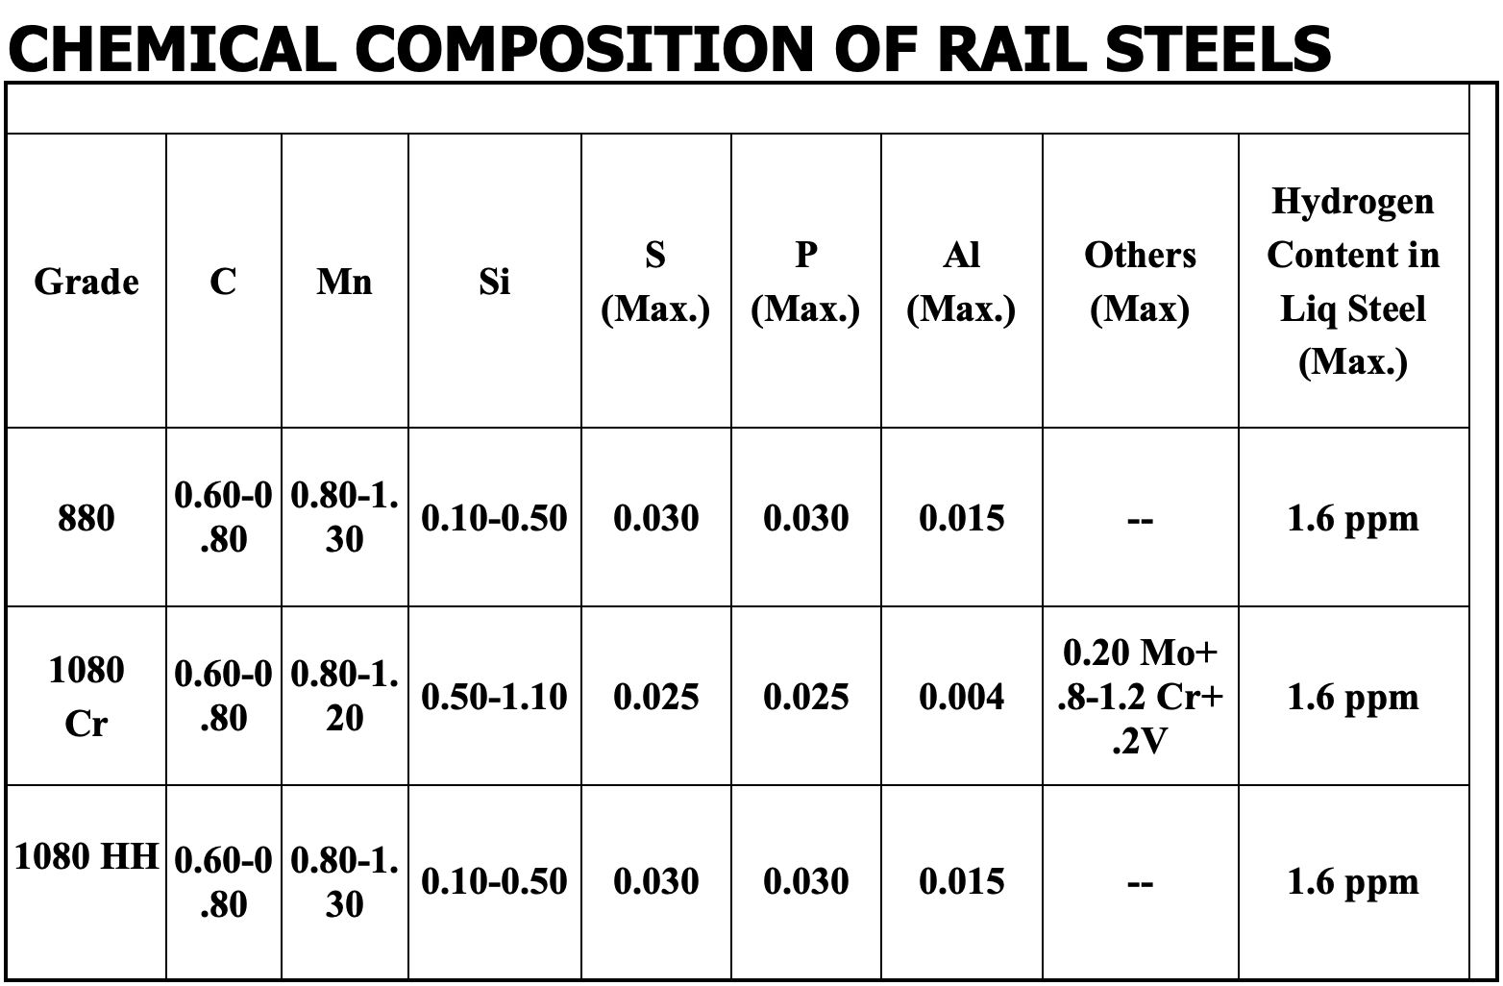
The chemical composition of Steel , the functions of specific element was mentioned in last slide .
Material Structure

Slide 9
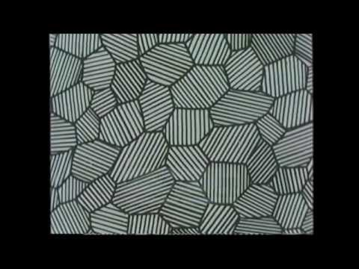
Effect of carbon content and heat treatment on microstructure of steel is beautifully shown in this video !

Slide 10
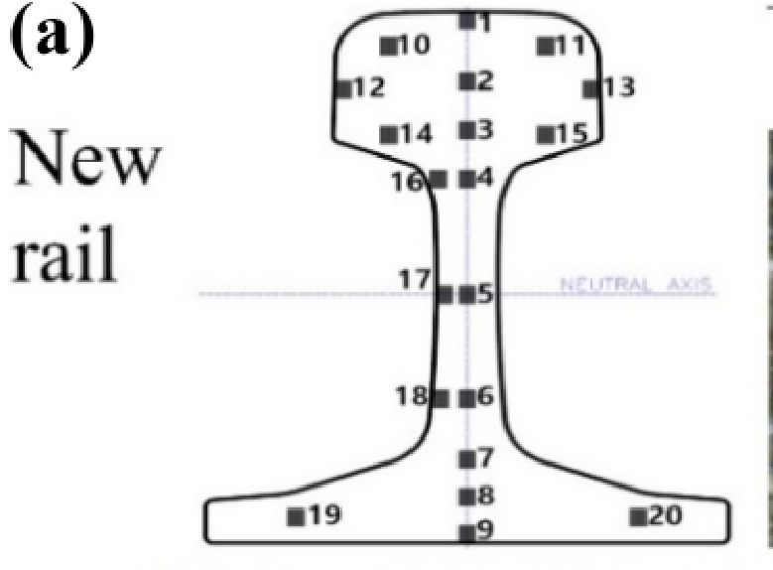
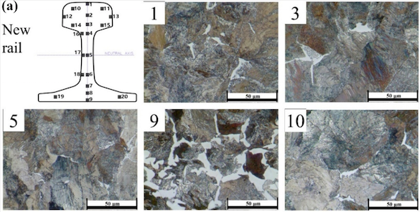
Steel microstructure
Different numbers signify the different point of the rail !(Play the slides for better view)
The three rails had different microstructures in the railhead, while the other positions had similar pearlite structures.This was due to the effect of the additional heat treatment followed by moderate cooling.

Slide 11
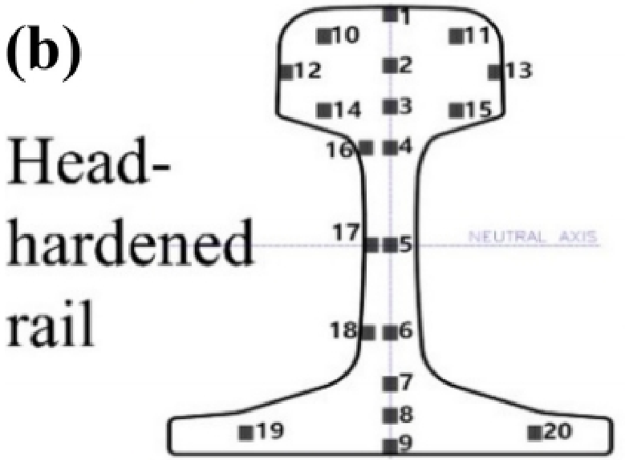
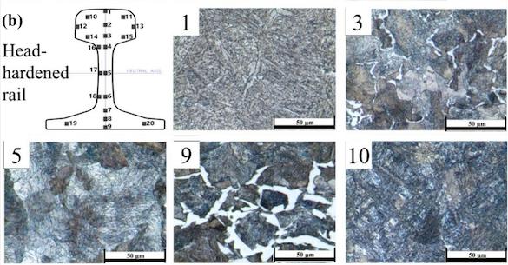
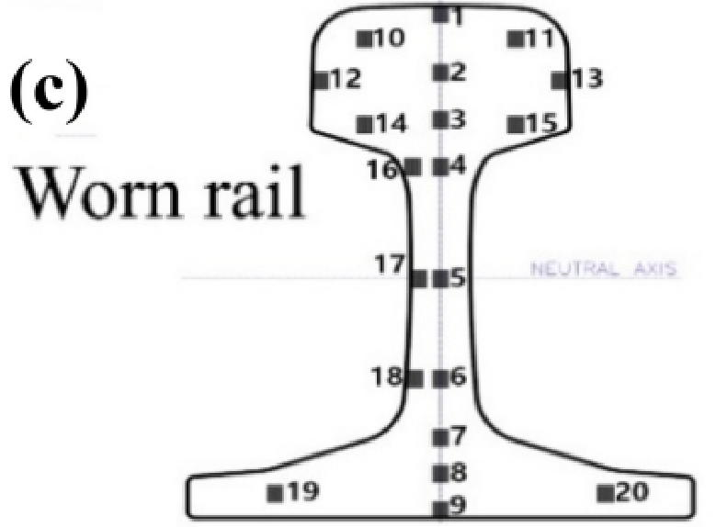
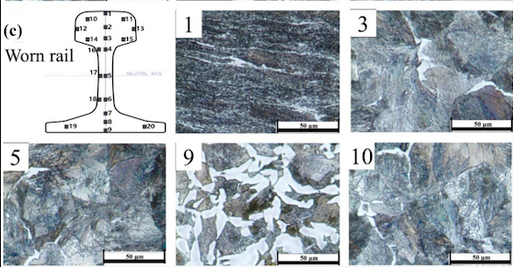
The other two type of rails , have different microstructure , due to the heat - treatment in (b) and continues stress in (c)

Slide 12
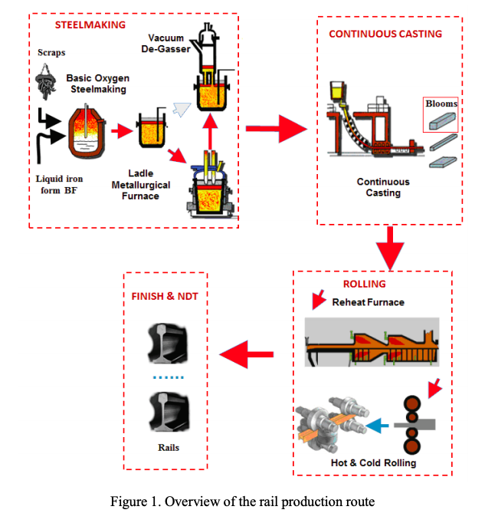
PART 2

Slide 13

This video concisely summarises the manufacturing of Railway tracks

Slide 14
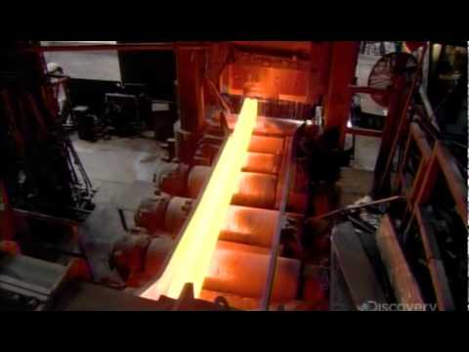
Processes involved in manufacturing Rails
This is how , in Industry , the steel rails are made ! using the mentioned processes.
Blast Furnace
Steel making
Continuous Casting
4) Rolling
5)Straightening
6)Measurements (testing parameters)
7)Final acceptance
We will be focusing mainly on Continuous Casting , Rolling and heating effect as they overlap with our course content !

Slide 15
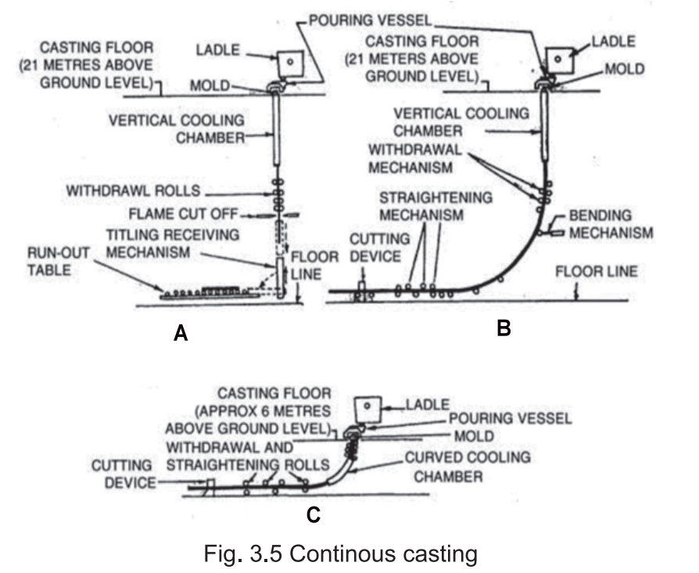
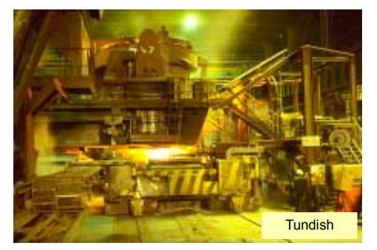
Continuous Casting
As the name suggest , this process is continuously casting steel .
The liquid Steel is poured in 150 tonne ladle which is inside the turret.
Then molten steel is poured from ladle into the tundish , the next ladle is prepared by the same process in the meantime and then poured in the same way and last batch comes out as bloom till that time .
In this way , this casting becomes a continuous process !

Slide 16
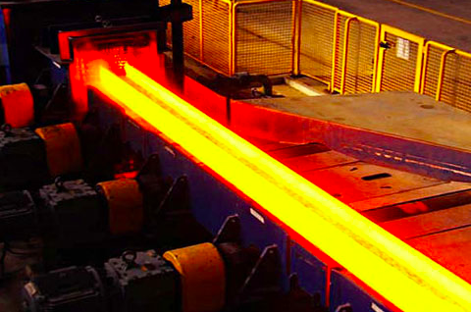
Rolling and Heat Treatment
Starting from the pig iron to reach till steel bloom after continuous casting .
Now , these blooms are rolled into the Rails .
Rolling breaks down coarse grain, makes the composition uniform , closes internal blow holes in steel bloom , breaks the inclusions and render them harmless .
Flat rollers processing the Rail web . The horizontal and vertical rolling releases the residual stress in the steel

Slide 17
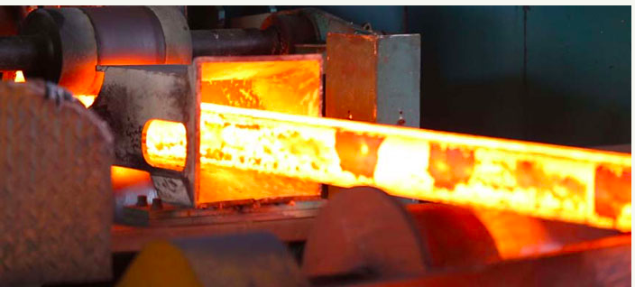
Rolling and Heat Treatment
Heating is done to improve the mechanical property of the rail drastically , so that it can withstand such a stress .
Nowadays , the most popular choices are quenching , tempering heat treatment and slow quenching

Slide 18
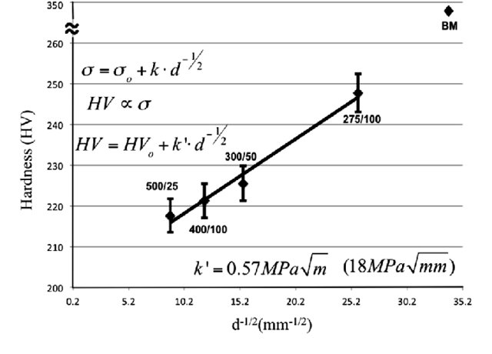
Grain Size effect on Mechanical properties
Hall-pitch Equation:
Polycrystalline metals usually shows a strong effect of grain size on hardness and strength !
The smaller the grain size , the greater is the hardness of the material.
During , Rolling and heat treatment , we take advantage of this fact to further strengthen the steel rails !

Slide 19
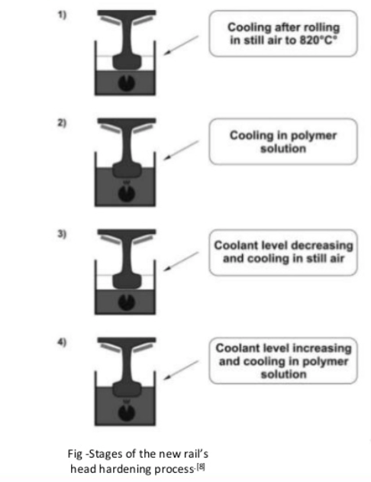
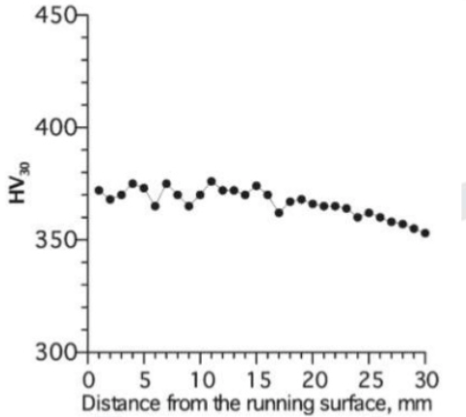
New Head - hardening process due to Rapid cooling !
Rail head is immersed in polymer solution for around 200 seconds due to which it undergoes intense cooling . The time is adjusted to get the perfect perlite structure .
The above figure shows hardness distribution as a function of distance from running rail !

Slide 20
Reference’s
From Research Paper in Journals:
Wookjin Choi¹, Min Ji Song¹, Nam-Hyoung Lim², Soo Yeol Lee^{1,*,}Microstructure and Mechanical Properties of Continuous Welded 50N Rail Published online: December 5, 2019
Y. Y. Yang, M. Mahfouf, G. Panoutsos, Q. Zhang , Adaptive Neural-Fuzzy Inference System for Classification of Rail Quality Data with Bootstrapping-Based Over-Sampling,2011 IEEE International Conference on Fuzzy Systems June 27-30, 2011, Taipei, Taiwan
2011 IEEE International Conference on Fuzzy Systems June 27-30, 2011, Taipei, Taiwan- pp:2
F.J.FranklinaJ.E.GarnhambD.I.FletcheraC.L.DavisbA.Kapoora,Modelling rail steel microstructure and its effect on crack initiation(2008) .
Brandon Talamini, Jeff Gordon ,FINITE ELEMENT ESTIMATION OF THE RESIDUAL STRESSES IN ROLLER-STRAIGHTENED RAIL (2004), pp:2 .
Brad baker , Processing-Microstructure Relationships in Friction Stir Welding of MA956 Oxide Dispersion Strengthened Steel ,(2014) : last figure
From Book chapter:
1) MODERN RAILWAY TRACK Second Edition pp: 275-300, ISBN 90-800324-3-3(2001)
2) Indian Railway Institute of Civil Engineering ,Rail Steel and Stresses ,pp: 1-30 (2019)
From Websites :
https://railroadrails.com/knowlege/how-are-railroad-tracks-made/
http://www.railway-fasteners.com/news/how-rails-are-made.html
http://www.railway-fasteners.com/rail-track.html

Slide 21

Dear Sir and tutors , I want to thank you all for carrying out this course so smoothly and putting so much effort for us to learn , I am really grateful to be your Student and I really enjoyed writing this presentation ,Learnt so much about Railways and its manufacturing processes ! It was a fantastic Ride !
Thank you for your time to read my presentation !

